Slide 1




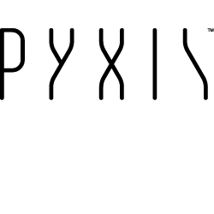

APPLYING DISCRETE GLOBAL GRID SYSTEMS TO SENSOR NETWORKS AND THE INTERNET OF THINGS
IGARSS 2017
Matthew B. J. Purss, Steve Liang, Robert Gibb, Faramarz Samavati, Perry Peterson, Clinton Dow, Jin Ben, Sara Saeedi
presented on behalf by P. Strobl, EC-JRC

Slide 2
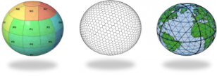
OUTLINE
What are Discrete Global Grid Systems?
What is the difference to classical Coordinate Reference Systems?
What specific advantages do they offer to the Internet of Things?

Slide 3
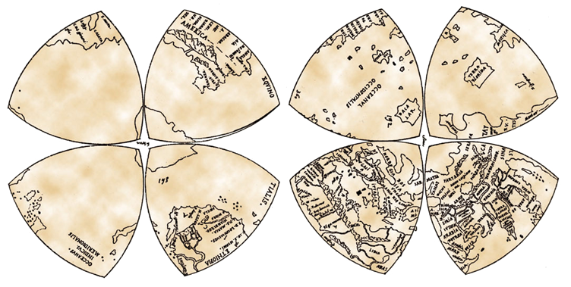
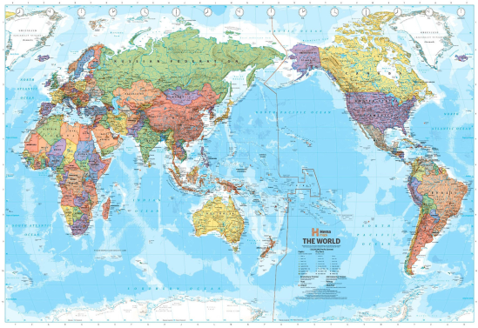


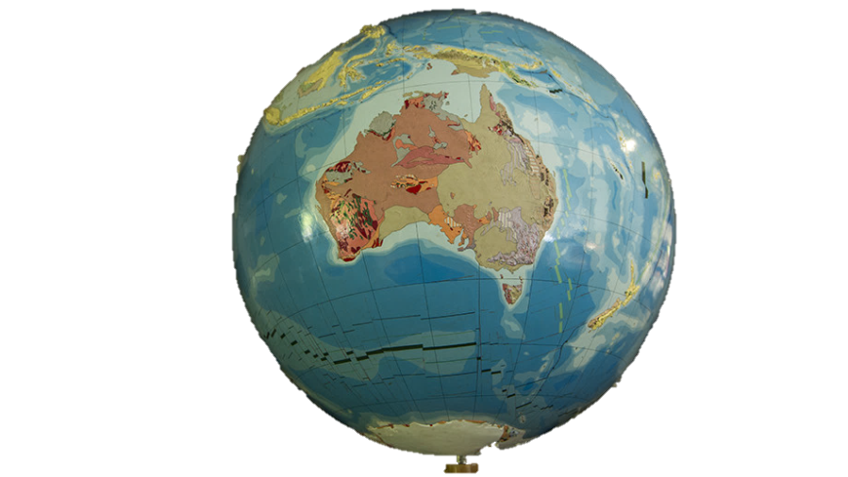



Where did DGGS come from?
Maps provide a way to put a globe onto a sheet of paper
c. 1506
But Computers are not limited to 2D
A globe is a good physical model of the Earth…
but difficult to fit into your pocket
What if GIS was based on a digital globe?
Conventional GIS puts the map
onto a computer screen

Slide 4
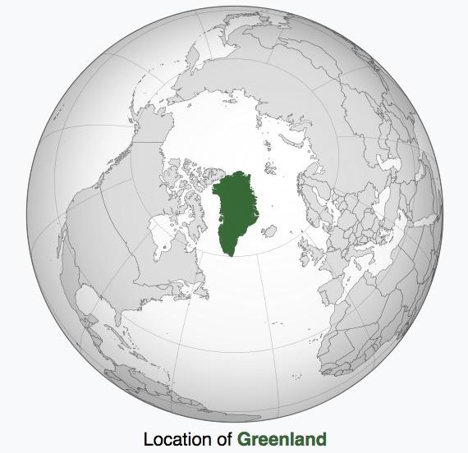

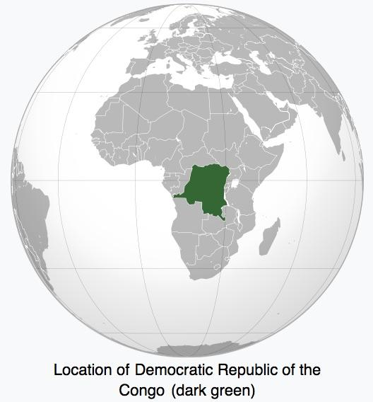
From GIS to the Digital Earth

Slide 5
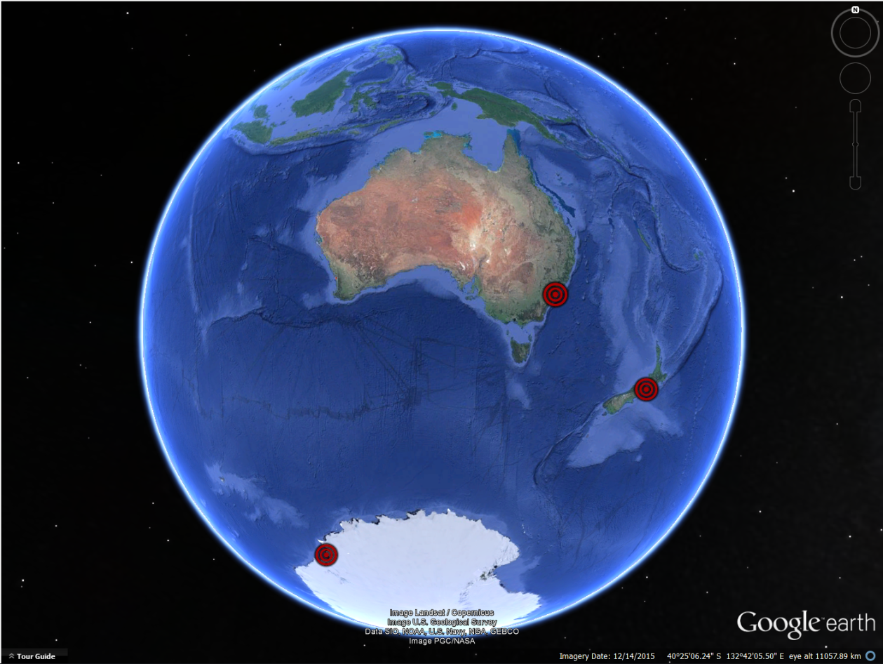
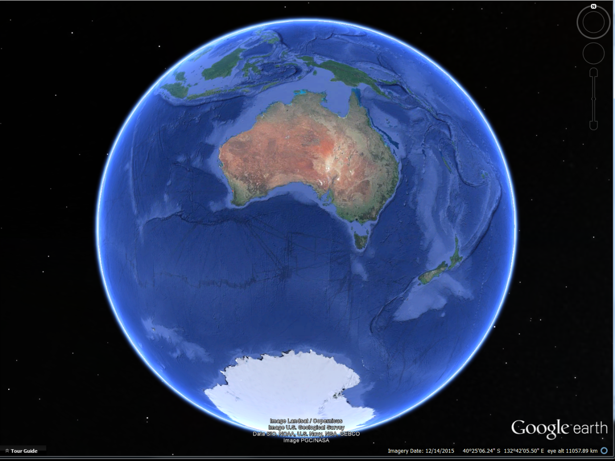
From GIS to the Digital Earth
Sydney, AUS
Wellington, NZ
Davis Station

Slide 6
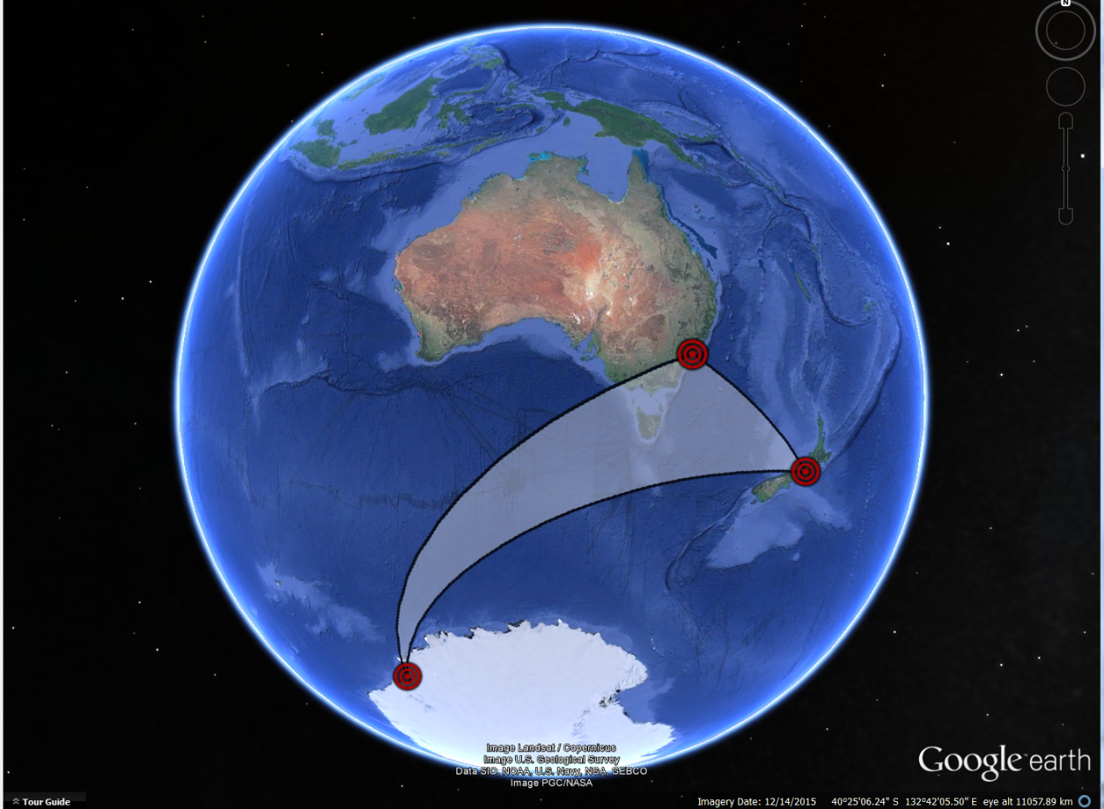
From GIS to the Digital Earth
Sydney, AUS
Wellington, NZ
Davis Station

Slide 7
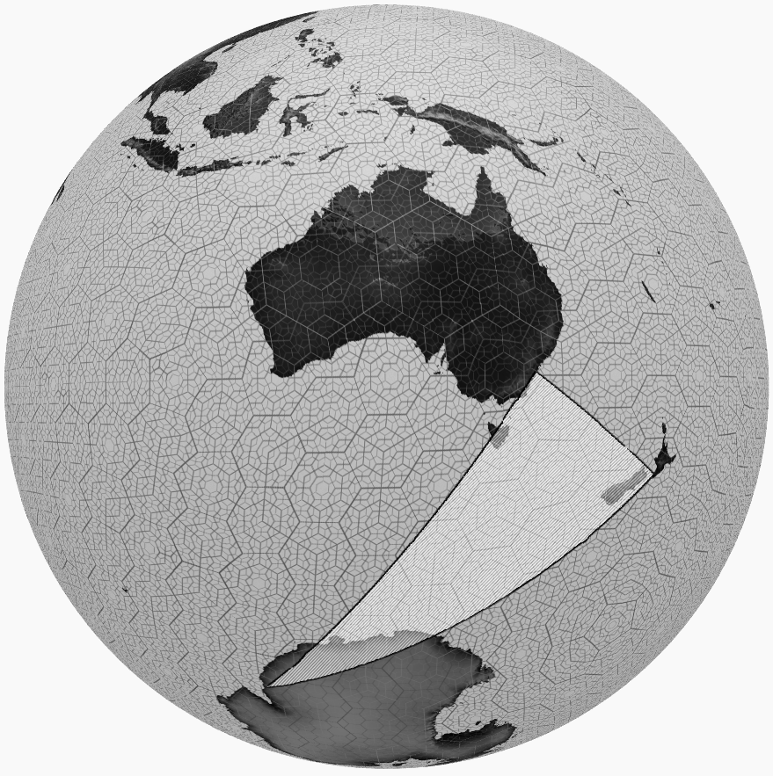
What if we didn’t ‘flatten’ things out?...
Sydney, AUS
Wellington, NZ
Davis Station

Slide 8
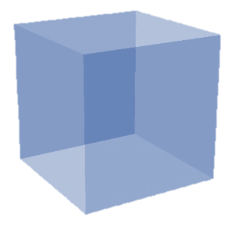

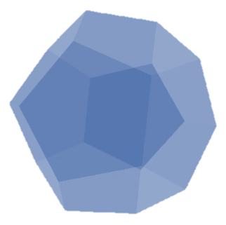
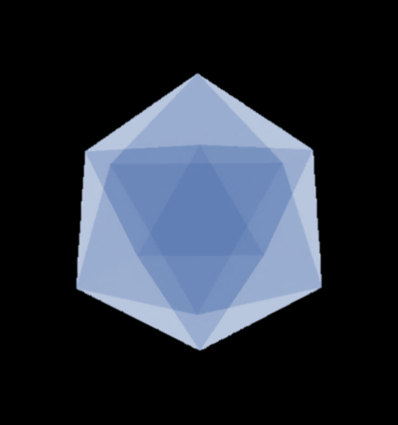

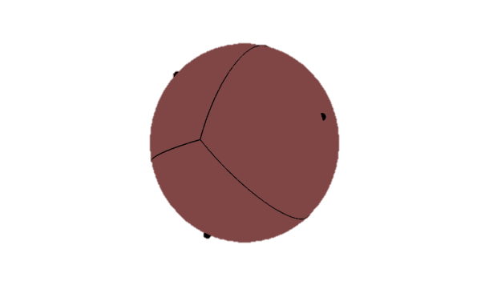
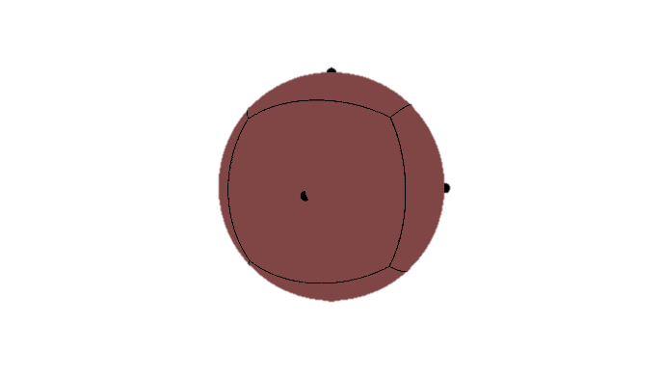
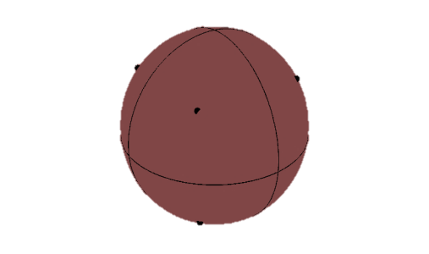
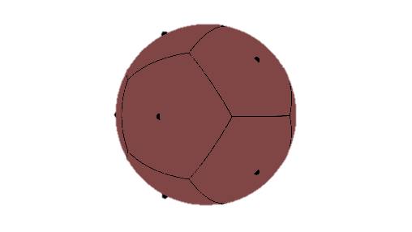
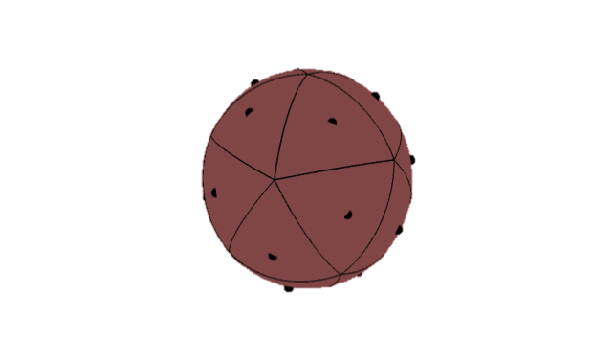
What are DGGS?
Equal Area Partitioning
Platonic Solids mapped to the Surface Model of the Earth (e.g. WGS84)
Tetrahedron
Cube (Hexahedron)
Octahedron
Dodecahedron
Icosahedron
Curved (NOT Planar) Grids
DGGS Grids are not planar grids – they are a polyhedral tessellation on the
Curved Surface of the Earth.
Tetrahedron
Cube (Hexahedron)
Octahedron
Dodecahedron
Icosahedron

Slide 9
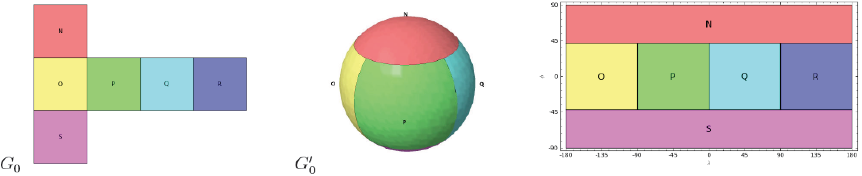
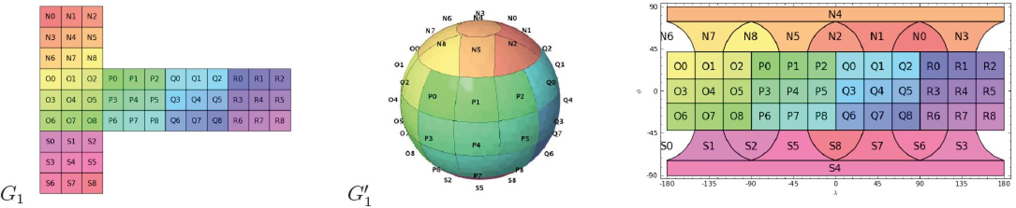
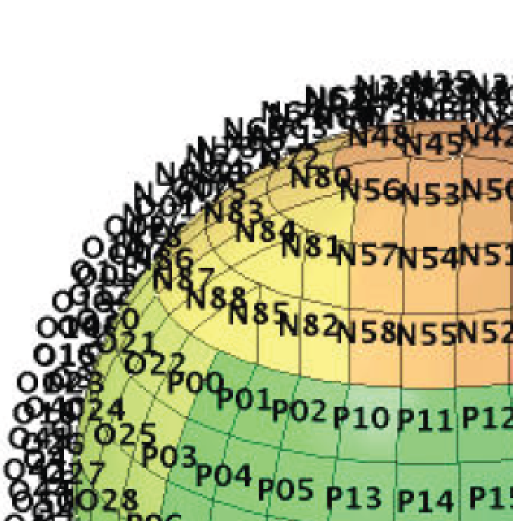
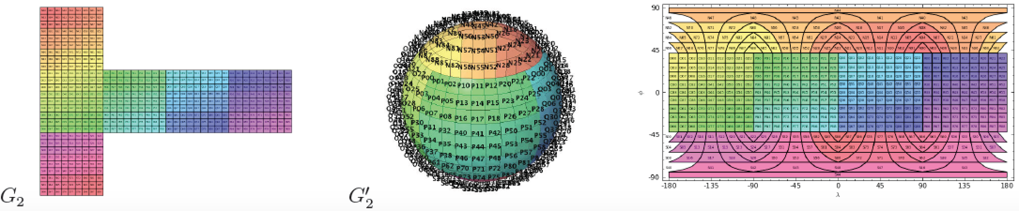
What are DGGS?

Slide 10
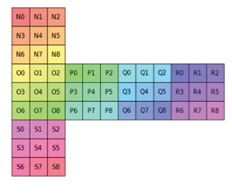
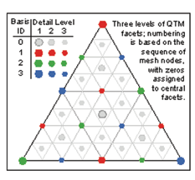
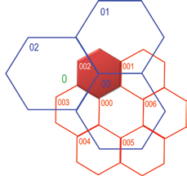
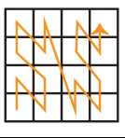
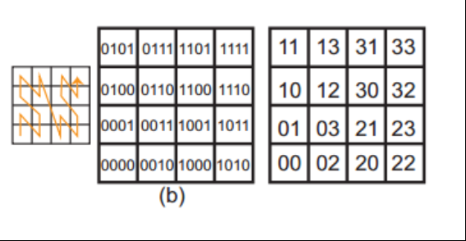
What are DGGS?
Different Cell Shapes
Square = Familiar
Triangular = Fast
Hexagonal = Fineness of Fit
Unique Cell Indices
Hierarchy-based, Space-filling Curve, Area-axis-based or Encoded Address
nD Spatial Analyses
↓
1D Array Processes
0 | 1 | 2 | 3
00 | 01 | 02 | 03 | 10 | 11 | 12 | 13 | 20 | 21 | 22 | 23 | 30 | 31 | 32 | 33
Notes:
Not sure if you’ll want the different cell styles bits but you can use them if you like.
The key thing from what we discussed is the ability through a spatial indexing schema to map a 2D spatial coverage onto a 1D array for computation.

Slide 11
DGGS Differences by Analogy
 | Traditional | DGGS
Coordinate axis | Linear orthogonal | 2D space filling curve
Coordinate surface | Projected plane | Curved on ellipsoidal surface
Units | Classical meters / degrees | Integer-fraction of ellipsoidal-area
Coordinate values | Real or Integer numbers | Cell ID – as ‘direct position’ along space filling curve
Coordinate operators | Classical algebra + - / x > = < etc | Area spatial relations (DE-9IM): within, touch, intersect, etc + parent, child, sibling
Grid coverage | Single resolution | Intrinsic hierarchy of (nested) grids
Spatial uncertainty | By metadata | Explicit cell is O&M sampling feature

Slide 12

The Elephant in the Room!
We collect spatial data in ‘Real World’
Coordinates…
but we usually “flatten” the data
before we try to use it!
But How do we get all of the different grid systems talking to each other to do this?
We need to move away from
‘flat earth’ analytics to truly realise
the Digital Earth

Slide 13

Developing the DGGS Standard!
DGGS SWG
March 2014
Adoption
June 2017
SWG Established
Candidate Standard Drafted
(6-18 mths)
Public Comment Period
(30 days)
SWG Review and Response to Comments
OGC Vote to adopt Standard
(45 day vote)
OGC Approval for Adoption
OGC Standards Development Pipeline

Slide 14
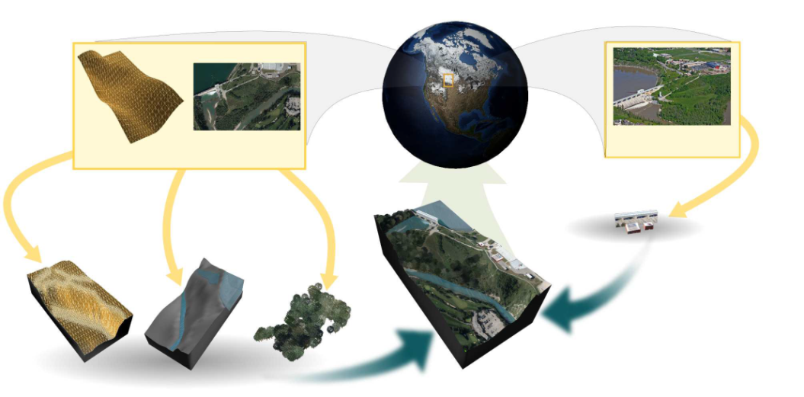


Summary
Technologies based on DGGS reference frames can facilitate rapid discovery, visualisation, analysis, fusion and dissemination of diverse geospatial & geostatistical data.
DGGS have the potential to transcend and therefore unify the traditionally divergent paradigms of raster, vector, point-cloud & gazetted place.
DGGS are inherently suited to cloud- and HPC-based computing environments.
DGGS provide a common spatial analysis
framework that has many synergies with the
proposed UN-GGIM Global Statistical Geospatial
Framework.
(Samavati, F., & Runions, A., 2016, fig.3)

Slide 15
DGGS and IoT
Explosion in the volume, velocity and variety of geospatial and geoscientific data due to rapid growth in global sensor networks
IoT data is usually point based but has finite spatial and temporal resolution
Uncertainty and coverage are often ignored in referencing through infinitesimal point location (CRS)
In a DGGS sensor data may be stored using both the location and resolution/coverage of the sensor in question
DGGS offers cells of appropriate size which are universally compatible and extremely efficient for storing and analysis

Slide 16
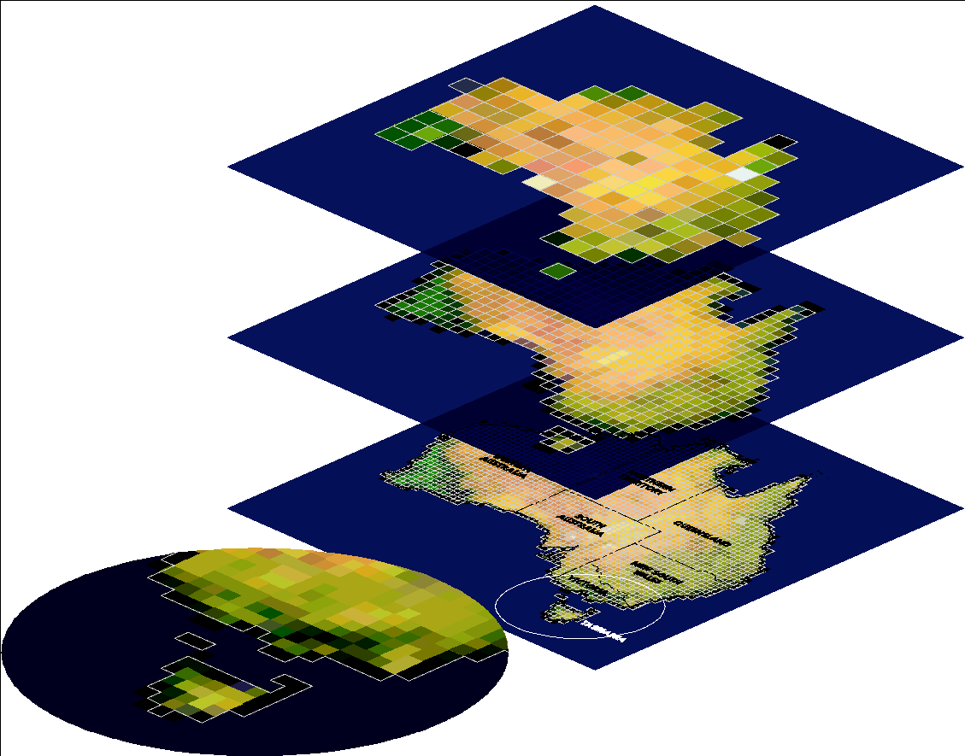
A problem with ‘Big Data’ and the ‘Digital Earth’…
The Conventional GIS approach
to the Digital Earth doesn’t scale
Arbitrary rasters need resampling
before we can integrate data
The ANZLIC National Nested Grid was
a good start for raster integration…
But how do we integrate vectors????

Slide 17
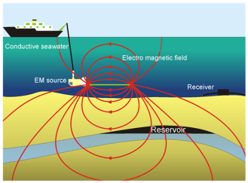

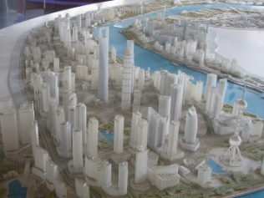

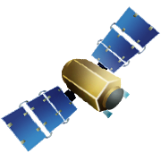


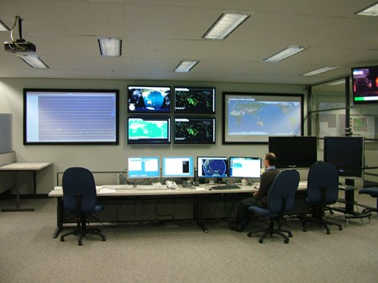


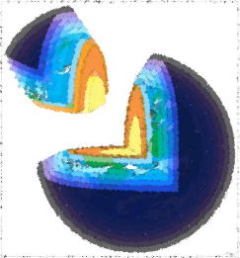
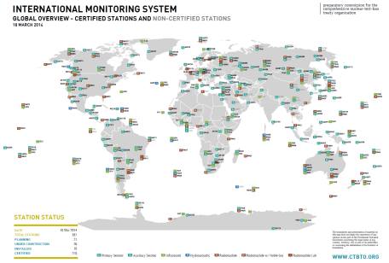

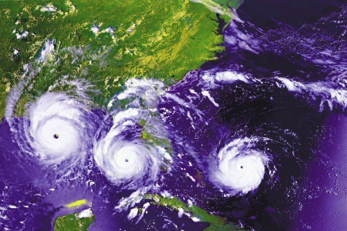
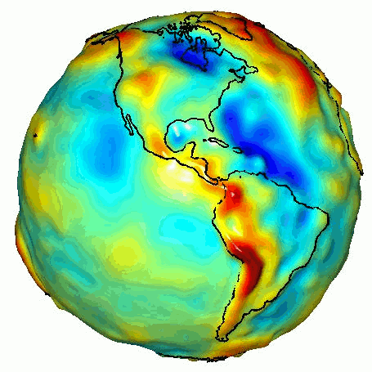
The Role of DGGS in the IoT
But…
Without a new approach to geospatial information
Data Fusion is very difficult!!!

Slide 18
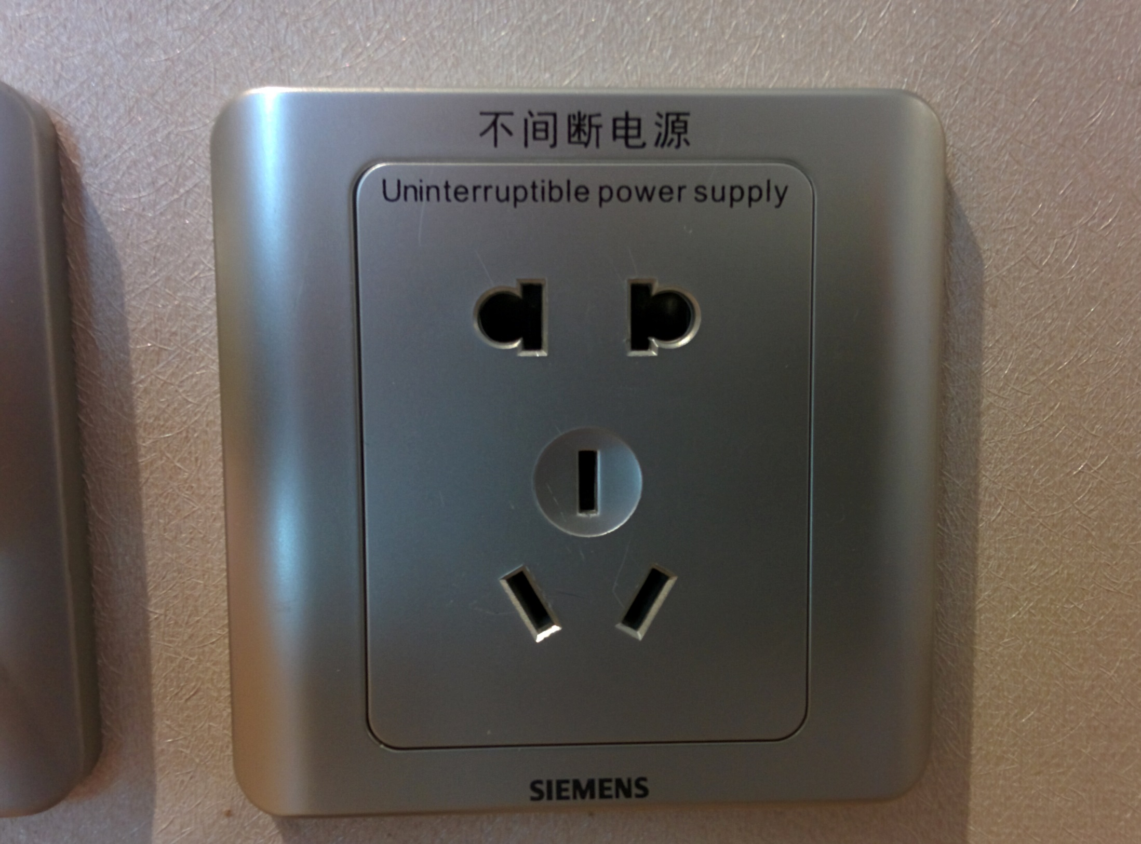
THE
OGC DGGS ABSTRACT SPECIFICATION IS A STANDARD TO BRING GRID SYSTEMS TOGETHER
NOT TO DICTATE WHICH SINGLE GRID
SYSTEM SHALL BE THE ONE TO
“RULE THEM ALL”

Slide 19

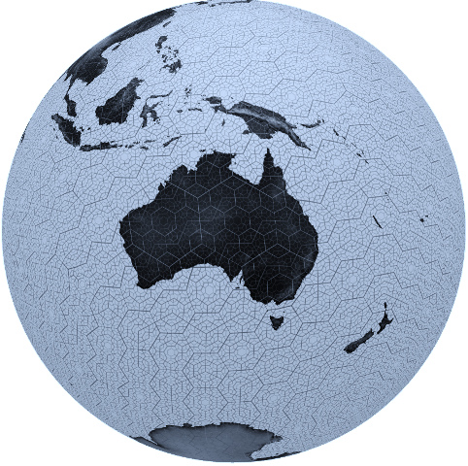
Thank you!
http://www.opengeospatial.org/projects/groups/dggsswg
Notes:
There are many different types of Discrete Global Grid Systems.
Some examples include:
The National Nested Grid – developed as an ANZLIC specification guideline in 2012
SCENZ-grid (or, Spatial Computation Engine for NZ) – developed by Landcare Research NZ
Earth System Spatial Grid – being developed under the GEOSS 2013-2015 workplan; and
Snyder Grid – Developed in a collaboration involving The PYXIS Innovation Inc.
There is a need for the development of a standard to enable interoperability within and between Discrete Global Grid Systems and to promote reusability, knowledge exchange, and choices between different data sources and architectures.
The Open Geospatial Consortium’s Web Service Architecture presents a promising set of technologies to enable this fusion between Discrete Global Grid Systems.

